Slide 1

Great Malaysia AI Hackathon Slide
Group Swincoders

Slide 2
Problem Statement
Deliver personalized short 5-minute daily learning sessions to employees.
Explanation
Long training sessions reduce retention. Build an AI platform that identifies skill gaps and pushes short, engaging lessons daily to employees, adapting difficulty and content based on progress.

Slide 3

Solution
An AI-Powered Micro-Learning Platform using AWS services that delivers personalized, 5-minute daily lessons to employees via email.
System Capabilities
- Analyzing employee skill gaps (stored in DynamoDB)
- Using AWS Bedrock AI models to generate engaging, bite-sized lessons with quizzes and theory
- Delivers lessons automatically via Amazon SES (email)
- Triggering daily lesson delivery tasks to employees using Amazon EventBridge
- Tracking user progress and data in DynamoDB database
- Can be manually triggered via API Gateway

Slide 4
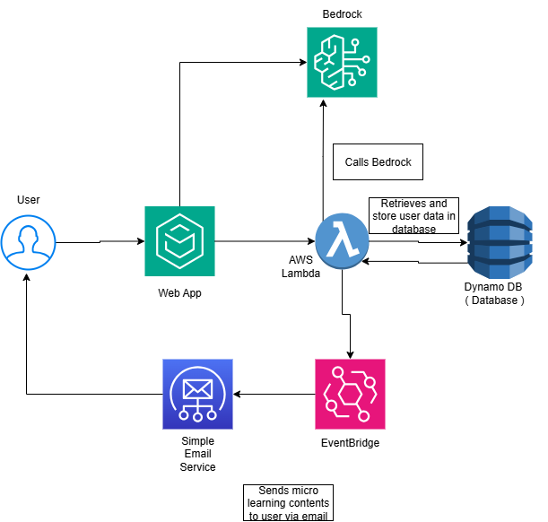
Architectural Diagram

Slide 5
The system employs an event-driven, serverless architecture where services are orchestrated via AWS Lambda in response to scheduled (EventBridge) or on-demand (API Gateway) triggers. User context is retrieved from DynamoDB, content is sourced from S3 or synthesized via Bedrock, progress is persisted, and the final artifact is delivered via SES. This design ensures:
Personalization through AI-driven content generation (Bedrock + DynamoDB)
Automation via scheduled execution (EventBridge)
Accessibility through ubiquitous email delivery (SES)
Scalability & Cost-Efficiency via serverless components (Lambda, DynamoDB, S3)
Extensibility through API-first design (API Gateway)

Slide 6

Solution Addresses the Problem Statement
Our solution is :
Micro-sized lessons (~5 minutes), cognitively optimized for retention
Daily delivery for fostering habit formation
AI-personalization to ensure relevance to individual skill gaps
Zero-friction access, via email hence no login or app required
Has progress tracking functions for enabling continuous improvement
OUR Solution also Aligns to these Cloud Computing principles :
scalability
cost-efficiency
operational simplicity
seamless integration.

Slide 7

Our solution replaces overwhelming training marathons with consistent, AI-curated micro-lessons thus improving retention, engagement, and skill growth without disrupting workflow.
This Photo by Unknown Author is licensed under CC BY-SA-NC

Slide 8
Services used

Slide 9
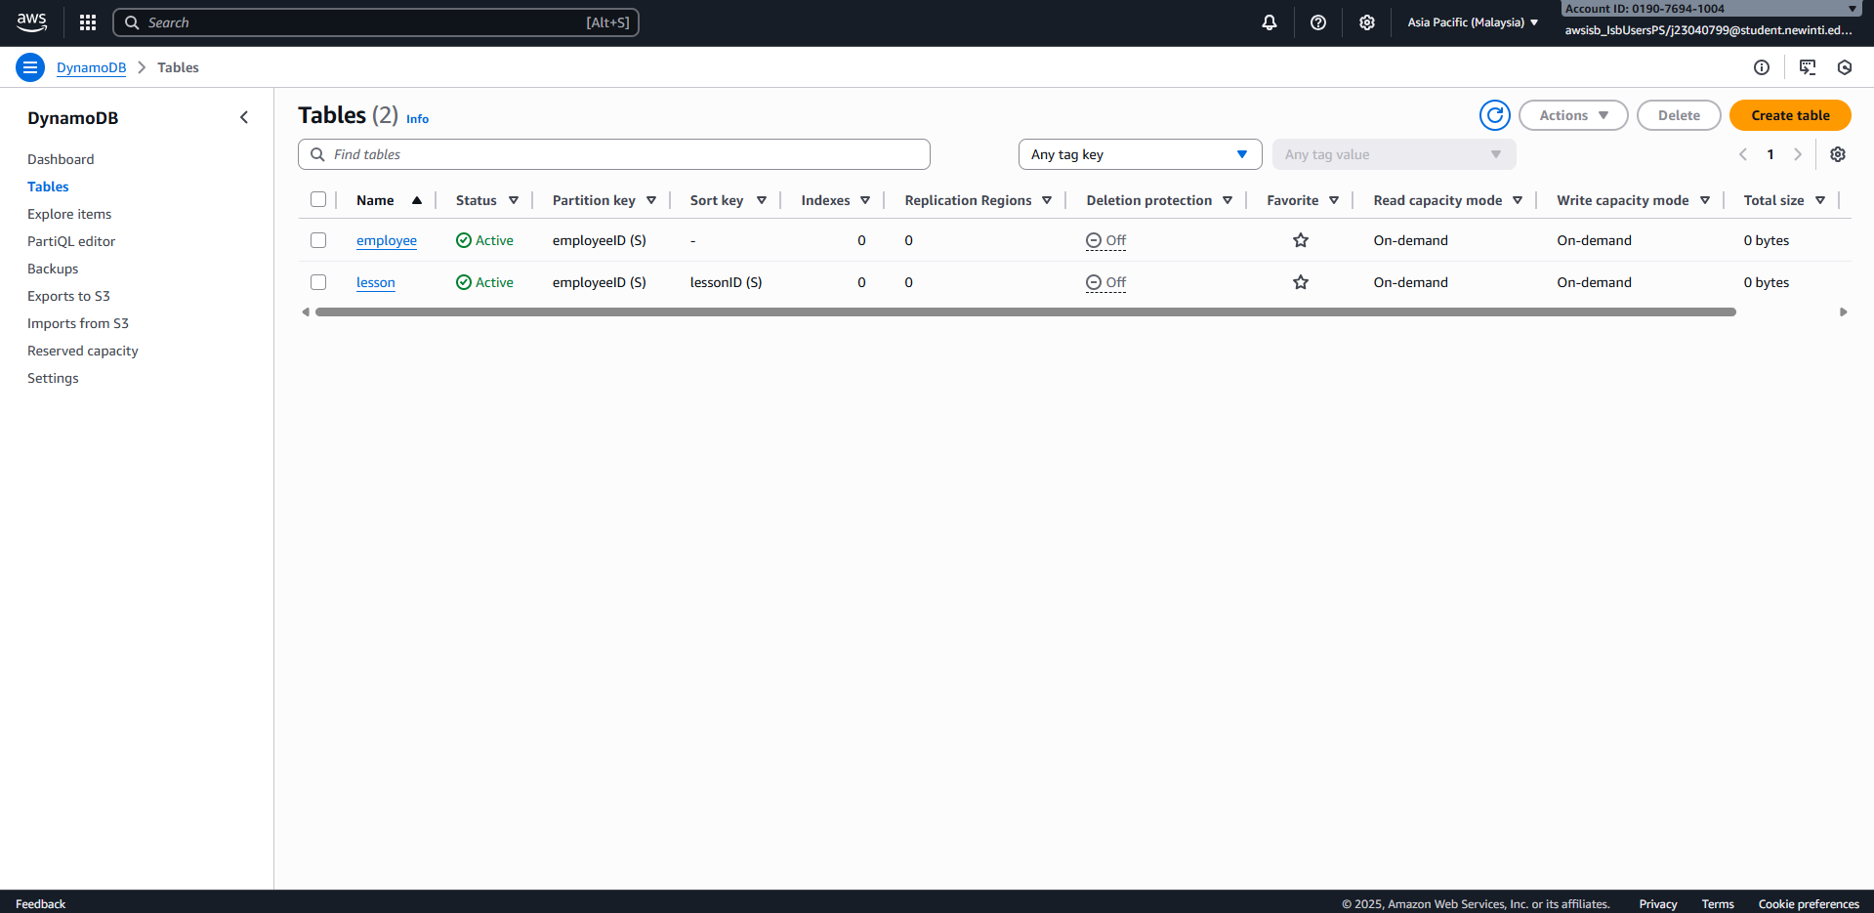
Dynamo DB

Slide 10
Role:
Stores user profiles: ID, skills, gaps, progress
Tracks completed lessons and last engagement date
Why We Used It:
Blazing fast (single-digit ms latency)
NoSQL → flexible schema for evolving user data
Serverless → no ops, auto-scales, highly available

Slide 11
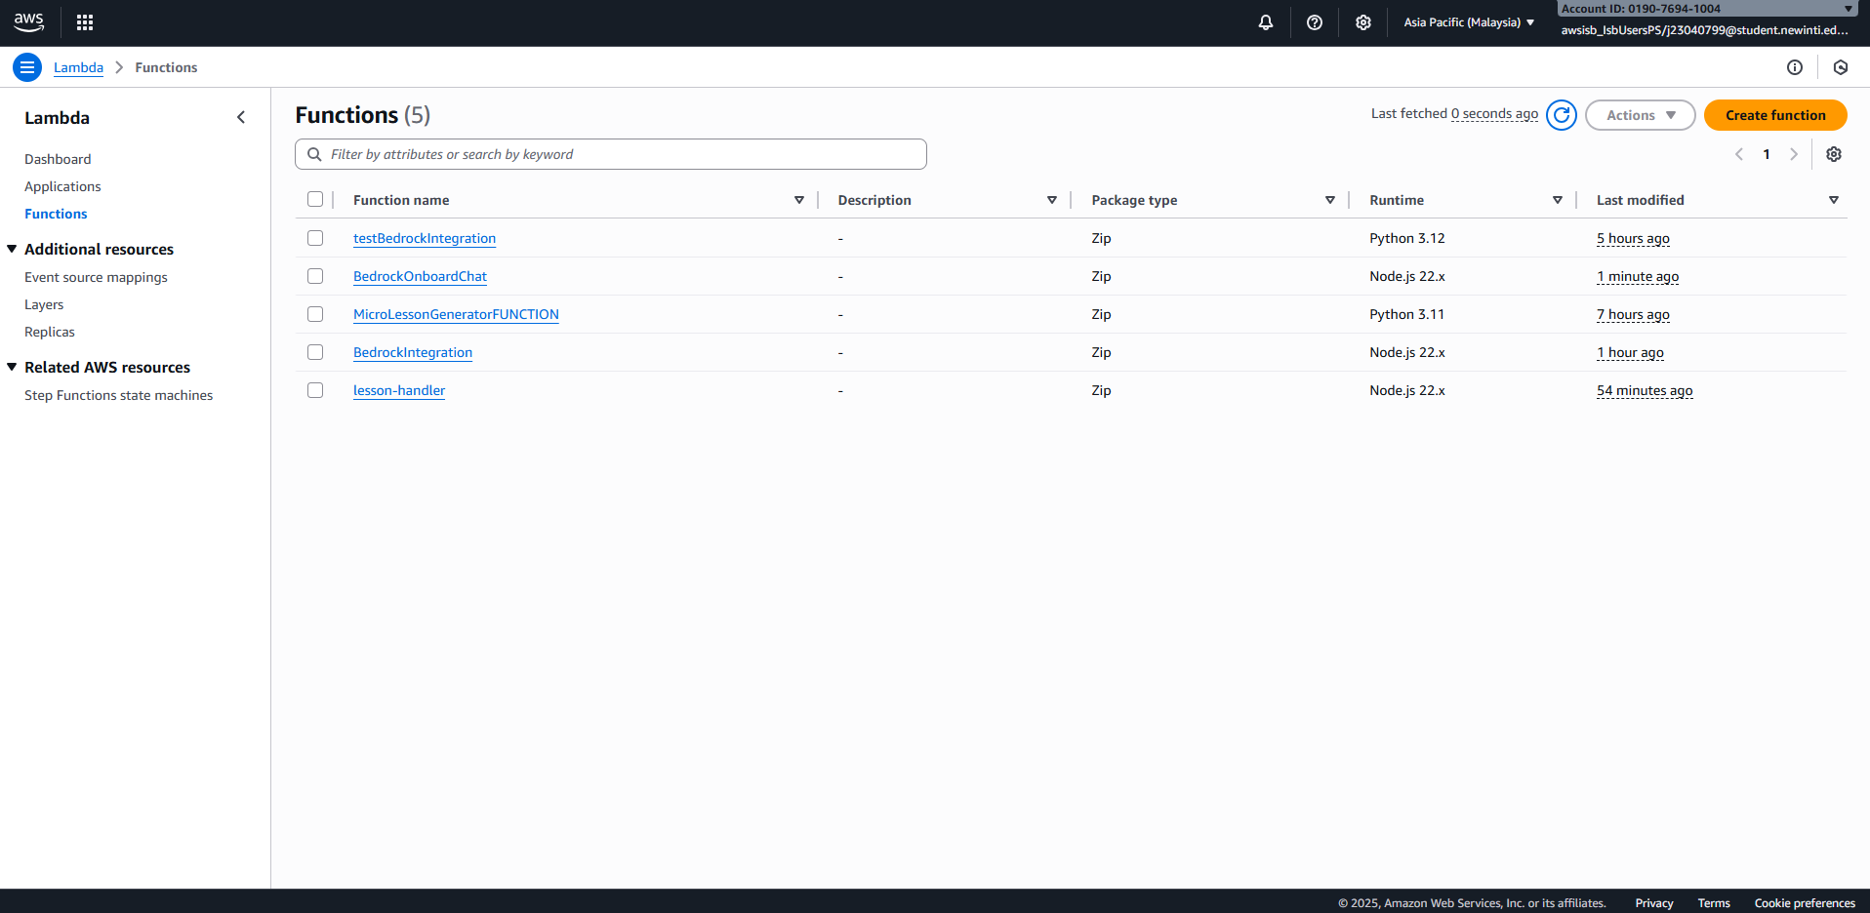
Lambda

Slide 12
Role:
Serverless “brain” that runs all logic
Triggered by EventBridge or API Gateway
Fetches data, calls Bedrock, saves progress, sends email
Why We Used It:
Zero server management → fully managed by AWS
Scales automatically → handles 1 or 1000 users
Pay only when used → cost-efficient for daily triggers

Slide 13
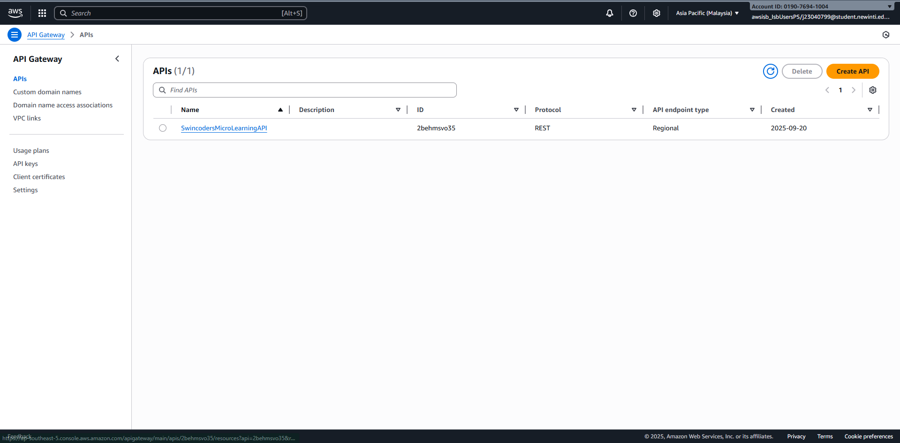
API gateway

Slide 14
Role:
Exposes REST API endpoint: POST /lesson
Allows manual lesson requests (web, mobile, admin)
Why We Used It:
Adds flexibility — users can request lessons anytime
Future-proof → easy to connect web/mobile apps later
Built-in security, throttling, and Cognito integration

Slide 15
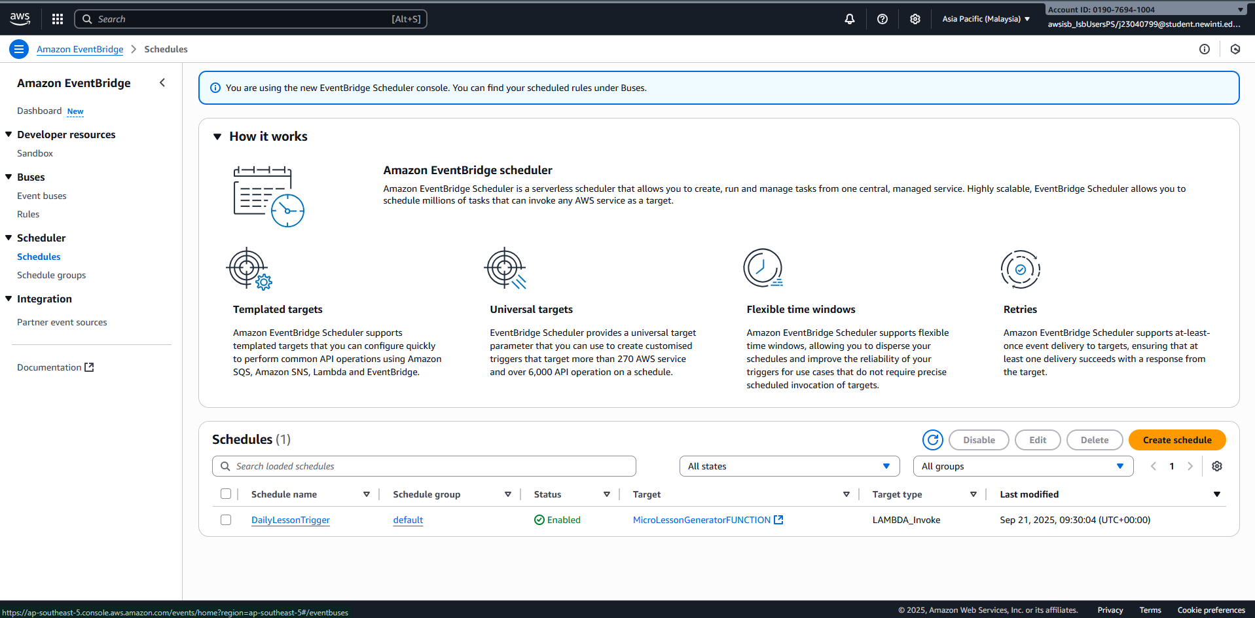
EventBridge

Slide 16
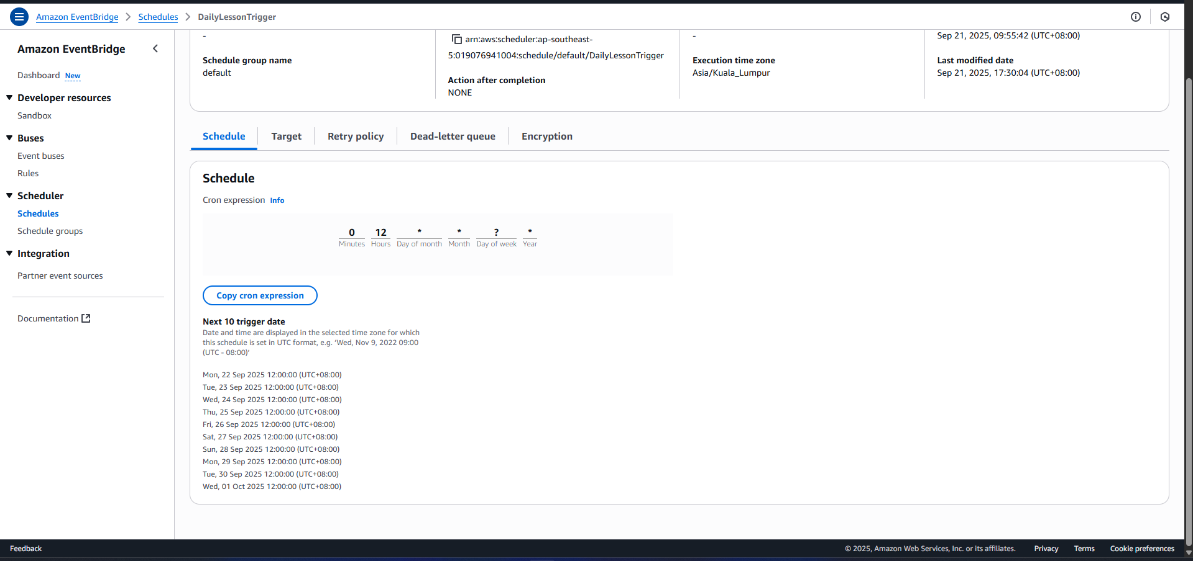

Slide 17
Role:
Schedules daily lesson delivery (e.g., 2 PM UTC)
Triggers Lambda automatically without manual input
Why We Used It:
Builds learning habit through consistency
Serverless scheduler → no cron servers to manage
Reliable, precise, and fully managed by AWS

Slide 18
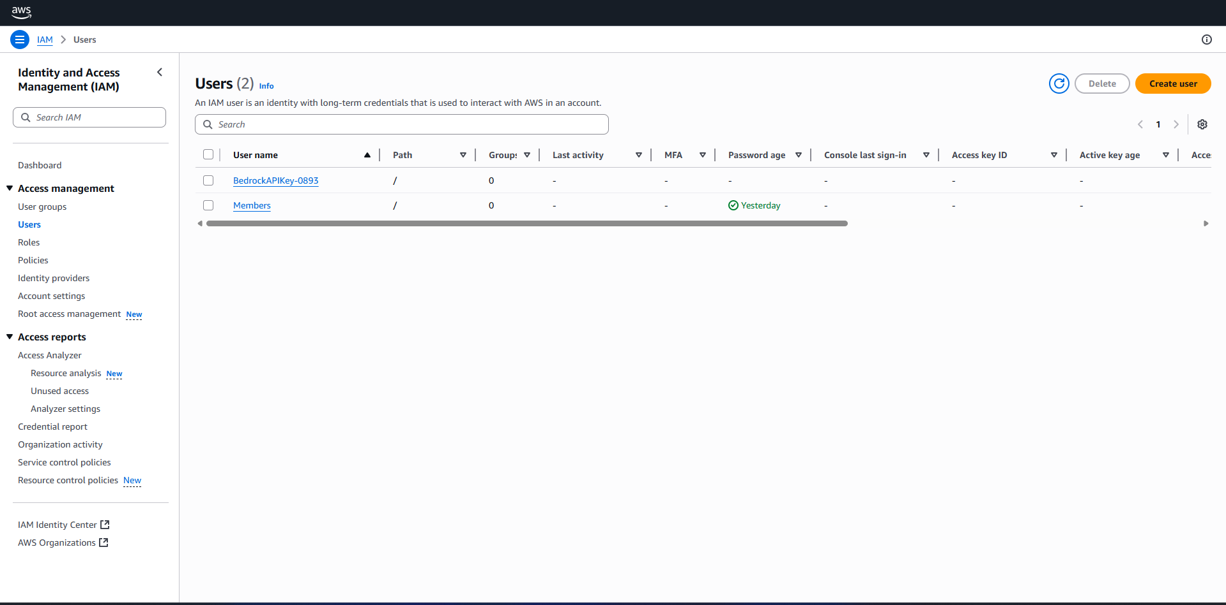
IAM user

Slide 19
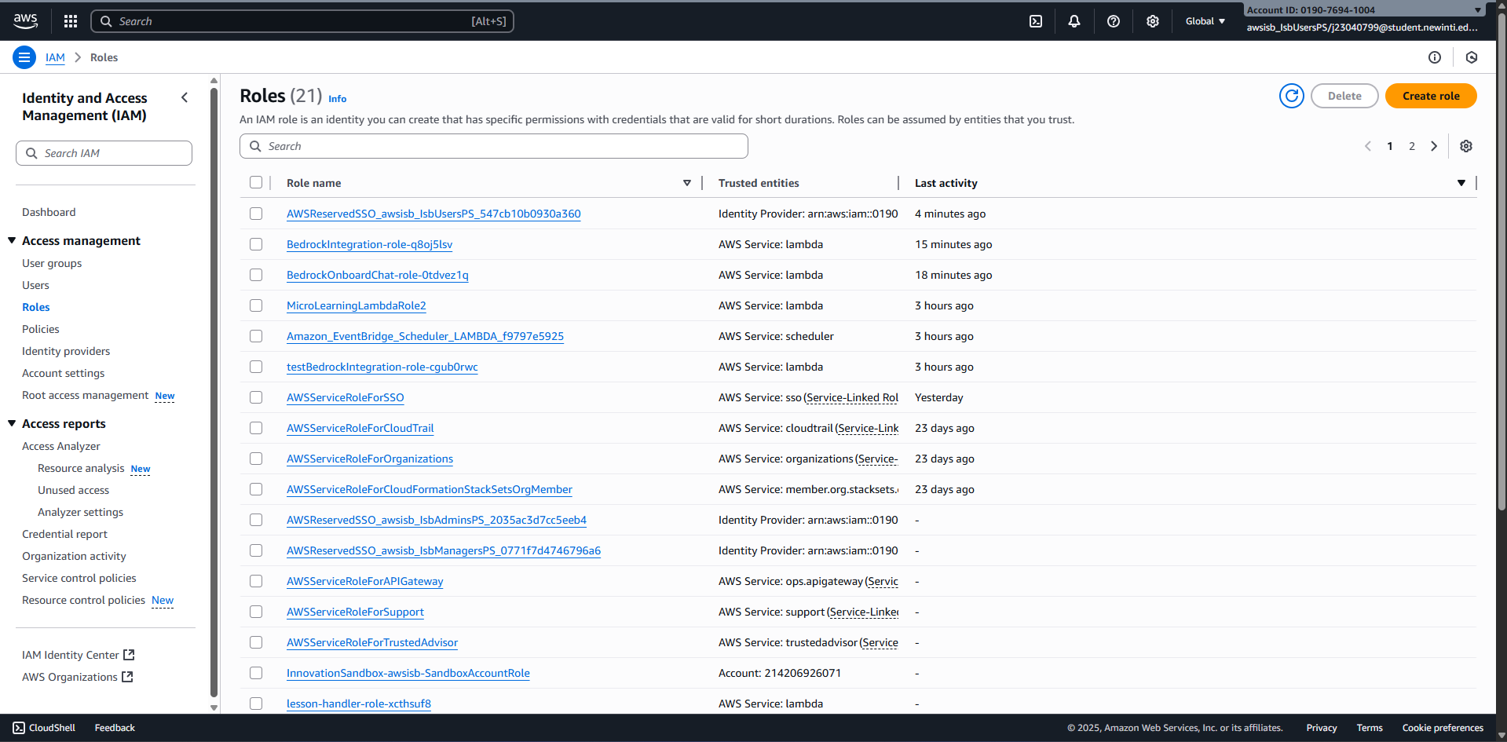
IAM roles

Slide 20
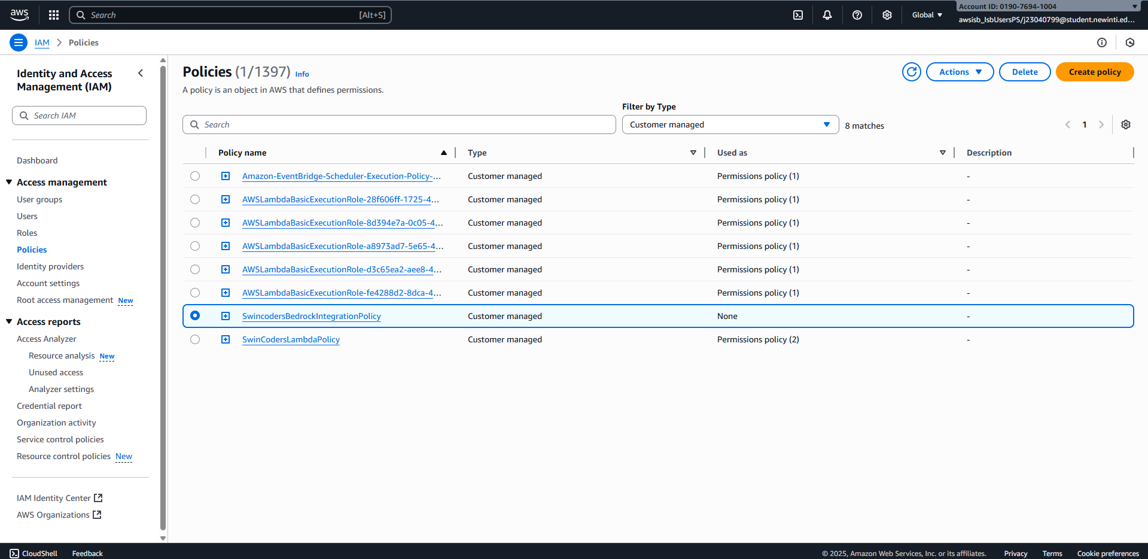
IAM policies

Slide 21

Role:
Manages permissions for AWS resources
Assigns “least privilege” access to Lambda, Bedrock, DynamoDB, SES, etc.
Controls who (or what) can do what in your AWS environment
Why We Used It:
🔐 Security: Ensures Lambda can ONLY access services it needs (e.g., invoke Bedrock, read S3, write to DynamoDB)
⚖️ Compliance: Follows AWS best practice — no overprivileged functions
🛡️ Risk Mitigation: Prevents accidental or malicious misuse of AWS resources
🔄 Scalable Permissions: One role (SwincodersLambdaRole) attached to Lambda — easy to update or audit

Slide 22
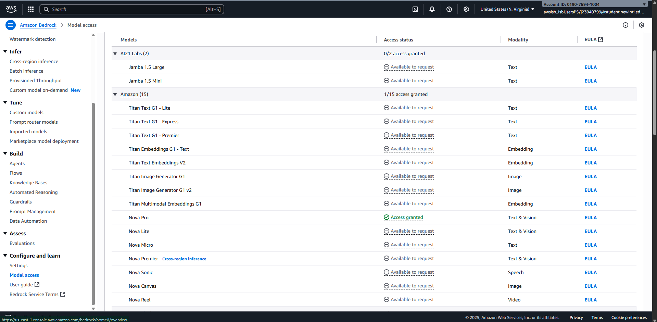
AWS Bedrock

Slide 23
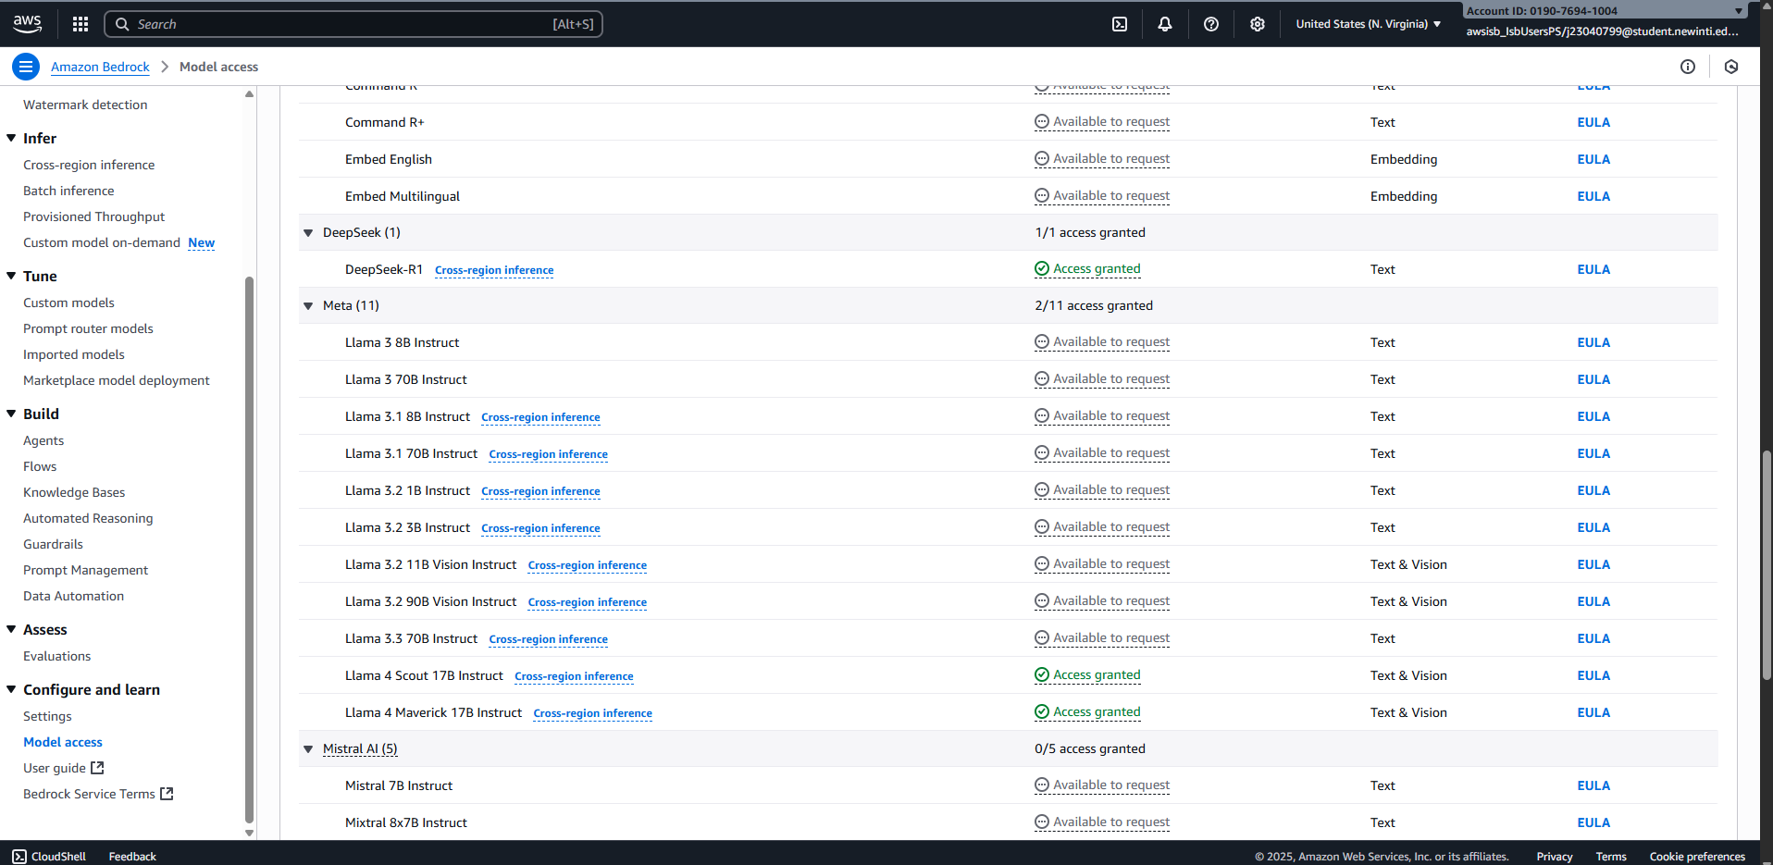

Slide 24

Role:
AI engine generating personalized micro-lessons
Uses Amazon Nova Pro to create content based on skill gaps, goals, and level
Why We Used It:
Replaces static training with adaptive, intelligent lessons
Ensures relevance and boosts retention through personalization
Serverless + API-driven → easy to integrate, no model management

Slide 25
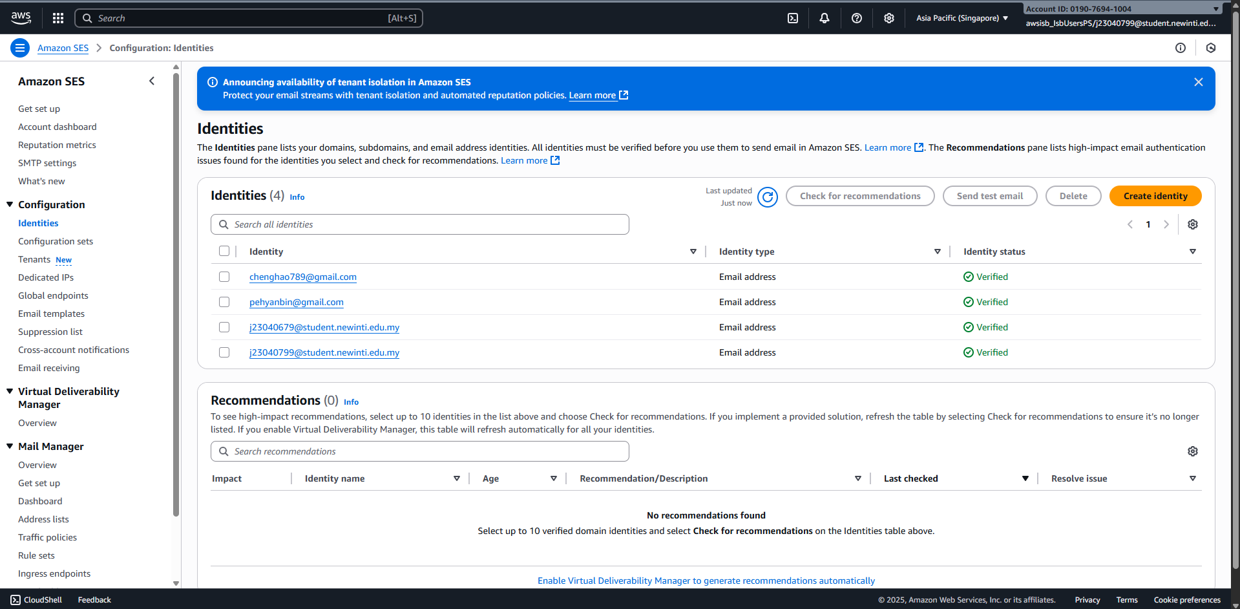
Simple Email Service

Slide 26

Role:
Sends daily micro-lessons via email
Delivers HTML-formatted, mobile-friendly messages
Why We Used It:
No app or login needed → lowest barrier to access
Trusted, scalable email delivery
Integrates seamlessly with Lambda + verified identities

